Slide 1

LatentView Analytics
Approach and Proposal
Jan 2021

Slide 2
Agenda
1
Introduction to LatentView
2
Business objectives
3
Proposed technical architecture
4
Proposed solution
5
Timeline and pricing
6
Engagement model and assumptions

Slide 3
Introduction to LatentView Analytics

Slide 4




LatentView Analytics is a recognized leader in Analytics and Insights
Over
700
People strong
Work with
30+
Fortune 500
firms
Rated as Top Analytics firm rated by Frost and Sullivan
5% Re-investment in Research and Development
Founded in
2006
Grown 11 times in last
six years
Only company recognized 9 consecutive times in Deloitte Technology Fast 50
>85% Repeat business
Awards & Recognition
AI Award Winner 2018
Winner at 2017 Netherlands Conference
2009-2017
Member of Technology council

Slide 5


























Trusted Analytics Partner to leading companies

Slide 6
Driving business benefits for our clients
Germany-based Iconic Automobile Manufacturer
A Global Technology Devices & Software Firm
Predicting vehicle risks across 108 countries by modeling driver behavior using sensor data
Improving ROI on Marketing spends of USD 1.6 Billion through Purchase Intent Modeling
AI Award Winner 2018
Winner at 2017 Netherlands Conference
German media and entertainment company
Data lake to enable TV spots revenue optimization
Case Study Presentation
Leading Online Payments Company
Leading US Based Beverages & Snack Manufacturer
Personalizing campaigns across consumer life cycle through proprietary LVM platform
Predicting consumer trends and preferences using machine learning
Largest Home Appliances Manufacturer in US
Enabling Product innovation through voice of customer

Slide 7




LatentView – The Trusted Analytics Partner
Envision the Future
Combining our deep math/tech skills with functional expertise to expand the horizons of a data-driven organization
CONSULTING
TRUSTED ANALYTICS
Execute for Business Impact
PARTNER
Enhance Decision Making
Robust analytics services model paired with Service Delivery Excellence to serve as an extended analytics arm of the organization
Industry and function specific products & assets to embed data-driven decision making within the organization
SERVICES
PRODUCTS
“ You Feel Like You’re buying a Partner who wants You to Succeed” - Forrester Research

Slide 8
Enabling the data driven decision-making journey by…
…getting the data together
…making sense of the data
...applying AI & ML to drive impact
Data Acquisition
Acquiring & consolidating the disparate data sources.
Data Engineering
Integrating various forms of data into centralized data lake using on-premise & cloud-based technologies
Data Processing
Process various forms of disparate data – Structured, Unstructured, Physical, Human Interactions, Machine Generated, Real Time etc
Business Analysis
Exploration of frequency, strength and direction of relationships & Causalities.
Exploratory Analysis
Deep insights from all forms of data using traditional methods (Segmentation & Clustering)
Visualization
Intuitive visualization for business users to gain insights for decision making
Real Time Analytics
Experience in sub-second big data processing for real time applications
Deep Learning & AI
Self governing systems leveraging AI & eliminating manual intervention
Machine Learning
Deep experience with various machine learning algorithms, including Ensemble Learning, Neural Networks, etc.

Slide 9
Five principles we follow that drive successful engagements
Client Context: Every Client and their situation is unique
Adoption is the Northstar for success
Engaging as a Trusted Analytics Partner
For a Leading Home Appliances manufacturer, while our solution was well received by 2,500 users, we continued to innovate to build IRA when usage starting falling
Balance the short-term considerations with the long-term vision. E.g: BI Transformation that we championed at Sony Pictures
For a Leading Asset Management firm, built a scalable Data Platform from scratch to track Business Performance
Business-led Insights
Cross-pollinating Ideas
For a Leading Computer Hardware manufacturer, our key differentiator was that we didn’t just execute blindly. We tried understanding what the context was and tailor solutions to the needs
Fostering ideas through cross-pollination through Roundtable, Idea Harvesting sessions, Cross-Industry Hackathons has helped us drive innovative solutions for clients. E.g. Panel Miner, SmartInsights

Slide 10
Business objectives

Slide 11




Business objectives
1
2
3
Stock out index
Milk route planning
Raw material inventory analysis
Current business state:
There is a diagnostic tool in place, which provides a summary of stockouts and its magnitude for a particular store/location.
It lacks prediction layer to predict potential stockouts in future.
Current business state:
Truck route planning is done manually. There is a lack of data driven approach to calculate the optimum route and schedule
Current business state:
Currently the purchasing team is facing a challenge in determining the exact raw material consumption due to the variations from the planning side.
This leads to difficulties in managing the optimum quantities of raw material inventory.
Desired Objective:
Build analytics capabilities to predict sales and flag a stockout on a given store on a given days in advance based on the historical sales, inventory and supply chain metrics available.
The solution should be able to accurately forecast the sales at the desired granularity (based on the available data) and identify the key indicators and factors that are causing these stockouts to devise a mitigation strategy
Desired Objective:
Build a route planning suggestion for Bridgestone's truck fleet to optimize the cost of transportations for the daily dispatch of orders.
Desired Objective:
Build a comprehensive dashboard and simulator that showcases the exact movement and inventory of raw material.
A simulator should provide the what if analysis of the impact of production variations on the raw material consumption and a identify the leading factors for production variations.

Slide 12
Technical architecture and solution approach

Slide 13






Solution Approach : Stock out index
The following solution is proposed based on availability of data, the output can be plugged into existing tool, or delivered as a new platform depending on the client’s requirement
1. Data
2. Predictive Analytics
3. Output
Demand Forecast
Stockout deep dive
Fit the models to the in-sample data and collect statistics on the out-sample
Probability of stockout of a particular master size at a particular store or cluster with in:
Month
Week
Day
Master size x Store level daily sales data to be aggregated and cleaned as per requirement
Additional data to be aggregated around store inventory if available like: inventory level, safety stock, in transit stock, lead times. etc.
Seasonal Profiles will be calculated at various levels
Trend profile based on product type and usage will be key input into the forecast.
Aggregated top down forecasts will be used as inputs for guidance for stockouts prediction
Variance analysis using waterfall
Use statistical analysis to deep dive into stockouts at:
Cluster level
Store level
Use business inputs to spin recommendations at cluster and store level to reduce stockouts
Choose the model with the best accuracy to fit the whole range of data
Identify and flag poor performing models for manual corrections
Repeat for all SKUs with less than 1 year of historic sales
Recommendations :
Cluster level
Store level
Suggested models:
ARIMA , PROPHET, TBATS, CROSTON
Inventory movement suggestion to route planning
Data : The following parameters are considered
( Plant, Branch,Date,`Mastersize, Class, opening stock, Forecast, Averagep, events, stockput)

Slide 14
Sample illustrative UI
ILLUSTRATIVE
Stock out overview
Forecast drilldown
Route planner
Raw material inventory
ILLUSTRATIVE
Product:
Model
Series B
Type
Regular
Brand
BS
Size
15
Product
B290
Location:
Region
South
Cluster
TN East
Forecast for next
Month
221
Cluster View
Drill down view
Period
Stores
Select threshold
50
Feb
ALL
Store ID | Estimated stock level | Estimated demand | Excess stock
Store 1 | 214 | 210 | 4
Store 2 | 370 | 362 | 8
Store 3 | 3311 | 3214 | 97
Store 4 | 625 | 750 | -125
Store 5 | 547 | 498 | 49
Total | 5067 | 5034 | 33
Recommendation :
Move 80 units from store 3 to store 4
Move 45 units from store 5 to 4
Stock more units at store 1 ( threshold reached )
Recommend offers for store 5 to clear inventory
Stockout estimated for period Feb 2021 due to low stocks at cluster
Refresh Drilldown view
Send to route planning

Slide 15
Sample illustrative UI
ILLUSTRATIVE
Stock out overview
Forecast drilldown
Route planner
Raw material inventory
ILLUSTRATIVE
Product:
Model
Series B
Type
Regular
Brand
BS
Size
15
Product
B290
Location:
Region
South
Cluster
TN East
Forecast for next
Month
221
 | Log Details | Remarks / Improvement Actions for next cycle
 | Dealer ABC tires in North Chennai ran clearance sale Baisakhi offers by Dealers in North India | Embed promotions data in the forecasting logic Closer follow up with store/dealer level promotions
 | Soft compound replaced by hard compound tires sales | Include consumer preference in the forecasting logic
 | WH mapping issues Distributor picking stocks from various locations in Mumbai | Sourcing Matrix to be frozen Mumbai distribution and WH mapping issue to be solved
 | Bridgestone S322 low sales in south Chennai Bridgestone B290 steady sales decline | Better forecasting instead of pushing the numbers Deep dive in the reasons for decline
 | Bridgestone S322 sales up 118% in Karnataka | Understand growth drivers and incorporate in forecast

Slide 16
Data Available

Slide 17
Milk route planning

Slide 18
Solution Approach : Milk route planning
The following solution is proposed based on availability of data, the output can be plugged into existing tool, or delivered as a new platform depending on the client’s requirement
1. Data
2. Predictive Analytics
3. Output
Linear Optimization model
Output
Define the decision variable and independent variables like store location, opening times, etc.
Master size x Store level daily sales data to be aggregated and cleaned as per requirement
Get inputs from the stockout module
Add business constraints from different sources
Optimized Transport plans at regular intervals
Cost & Variance reports
Visualization charts and reports
Visualize the output in the dashboard and share the route plan for each date with respective driver
Inputs constraints like:
Load volume
Schedule
Availability of trucks
Suggested models:
North West Corner Method
Simplex Method variations
Minimum Cost method
Vogel’s Method

Slide 19
Sample illustrative UI
ILLUSTRATIVE
Stock out overview
Forecast drilldown
Route planner
Raw material inventory
ILLUSTRATIVE
Fleet overview
Route planner
Select area:
Cluster
South
Date
Country
India
State
TN
01-02-2021
No. of Depots
2
Trucks Used
5
Destinations
3
Total Load
35 Tons
Date
01-02-2021
Truck No. | Depot | Destination | Load | Distance(Kms)
T101 | Chennai | Salem | 6000Kg | 345Kms
T102 | Trichy | Coimbatore | 7000Kg | 217kms
T103 | Trichy | Salem | 6500Kg | 140Kms
T104 | Chennai | Erode | 8000Kg | 405Kms
T105 | Chennai | Coimbatore | 7500Kg | 506Kms

Slide 20
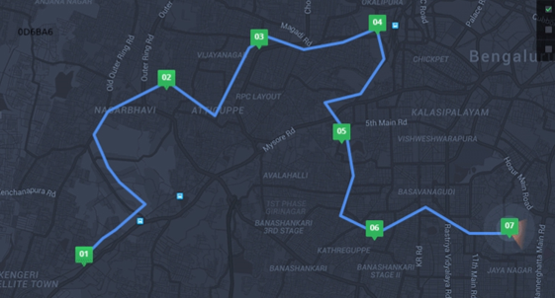

Sample illustrative UI
ILLUSTRATIVE
Stock out overview
Forecast drilldown
Route planner
Raw material inventory
ILLUSTRATIVE
Fleet overview
Route planner
45
5
3
3
521
45
0
Tasks planned
Trucks used
Trucks packed
On road
Total KMS
Total Hours
Total Deviations
Scenario outcome
08:00 | 10:00 | 12:00 | 14:00 | 16:00 | 18:00 | 20:00
Route 1
ID : 887AS
1
2
3
4
5
6
Route 2
ID : 43FS
1
2
3
Route 3
ID : 124VS
1
2
Recommended stops:
Warehouse 3321
Store 112
Store 987
Store 83
Store 32
Dealer 22
Route 4
ID : 1324VS
1
2
Download plan

Slide 21
Raw material inventory analysis

Slide 22




Solution Approach
Consolidate
Build
Plan
Insights
Identifying Insufficient and Excess Inventory
Set-up backend data mart for Dossier
Set and Refresh Inventory Targets
Analysis of Improvement Scenario
Initial flat files required
Current SAP based inventory excel
Suppliers Details
In-transit Inventory details etc.,
Staging &Reporting Layer
Phase 2:
Improve the metrics
Supply Chain Health
Inventory Analysis
SKU Analysis
Safety Stock Analysis
Cycle Stock Analysis
In Transit Analysis
Pre-Build Analysis
Scenario Analysis
Goal Setting Analysis
What-if Analysis
Raw material inventory
Dashboard using off the shelf product like Tableau / custom tool
Lead time
Dashboards should provide an end-to-end solution illustrating the flow of Inventory for both Raw Materials from point of origin till finished goods
A logical flow of dashboards should be built which provided a holistic snapshot of the supply chain network , capturing the key governing parameters from a category level to an SKU level
What-If analysis framework provides user a platform to simulate different scenarios and hence identify the optimal method to reduce excess inventory
Min. order quantity
Production schedule
Historical production data

Slide 23
Sample simulator UI
Inventory overview
Scenario analyzer
Inventory forecasts
Store comparison
ILLUSTRATIVE
Product:
Model
Series B
Type
Regular
Brand
BS
Size
15
Product
B290
Set Targets
Scenario outcome
Save
Select raw material
Type 1
Current
New setting
Set production frequency to days
2
3
Component | Current value ( $ ) | Scenario value ( $ ) | Difference
Inventory stock | 2547 | 2654 | 107
Order value | 6652 | 6854 | 202
Cycle stock | 3654 | 3214 | -440
Safety stock | 352 | 652 | 300
In transit | 250 | 250 | 0
Set inbound shipment frequency
2
3
Set outbound shipment frequency
2
3
Set input lead time days
5
3
Set quantity on hand ( X )
3250
3216
Set quantity on hand ( Y )
2514
2514
Simulate

Slide 24
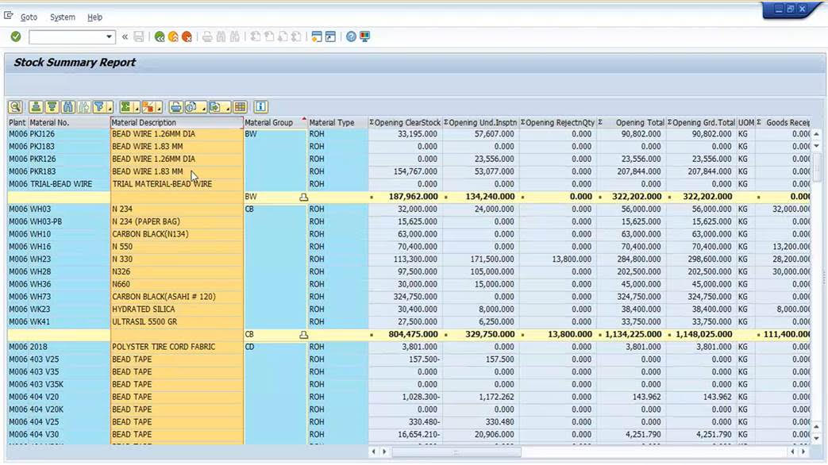

Slide 25
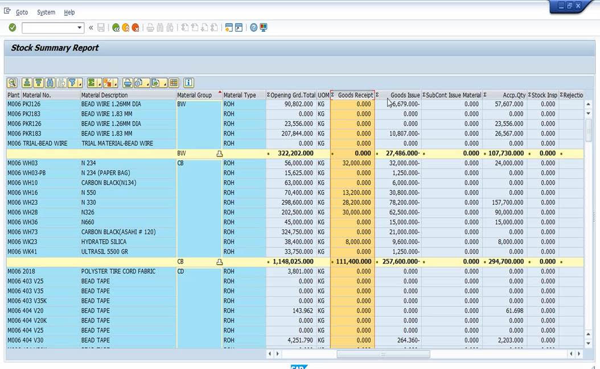

Slide 26
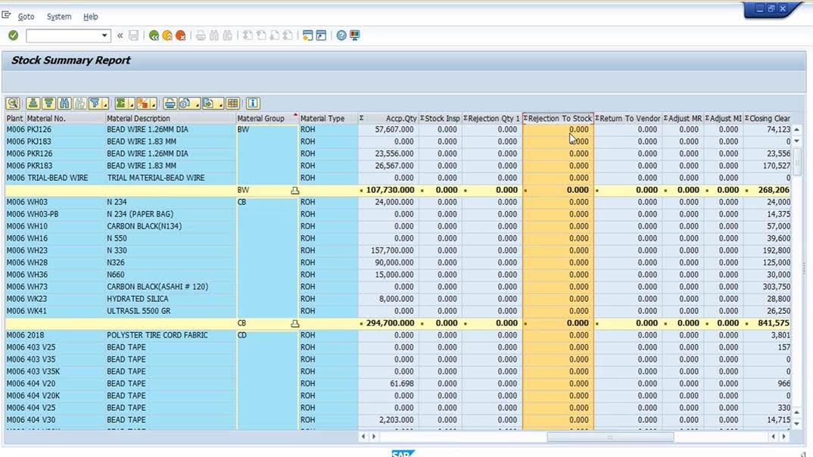

Slide 27
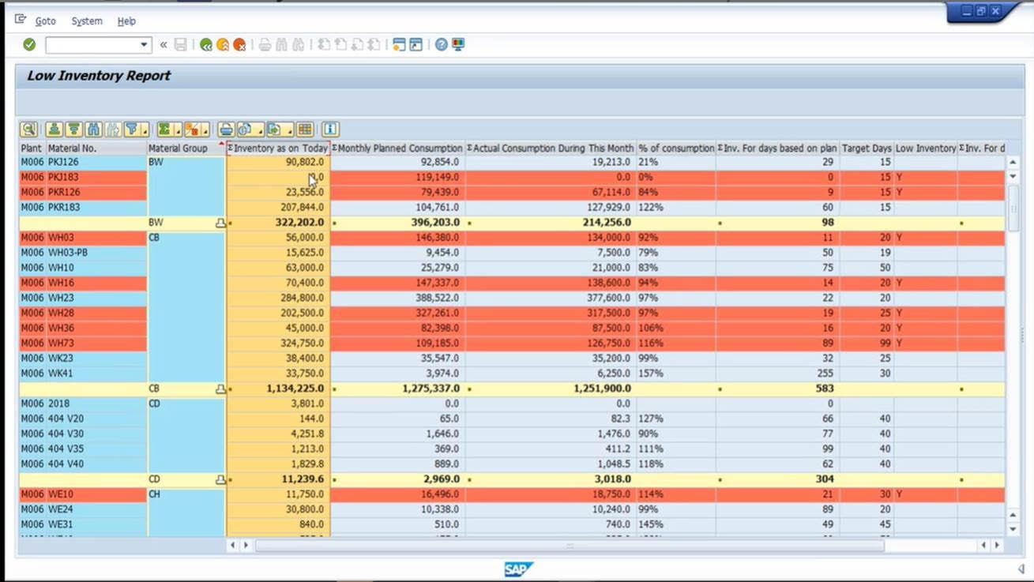

Slide 28
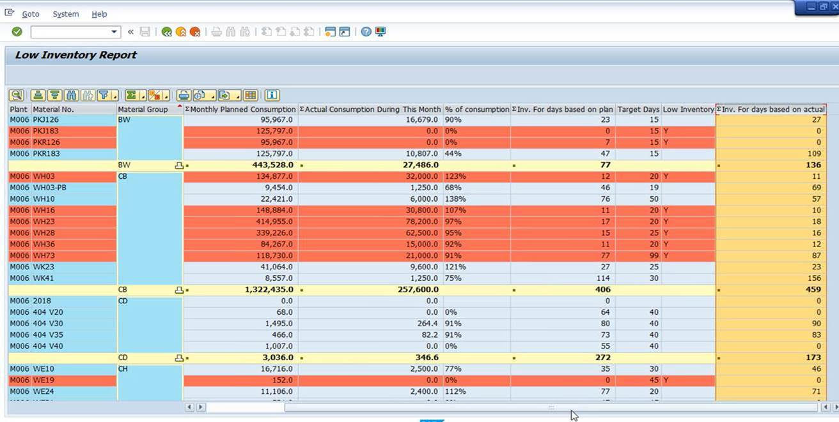

Slide 29
Timelines and pricing - Option 1

Slide 30
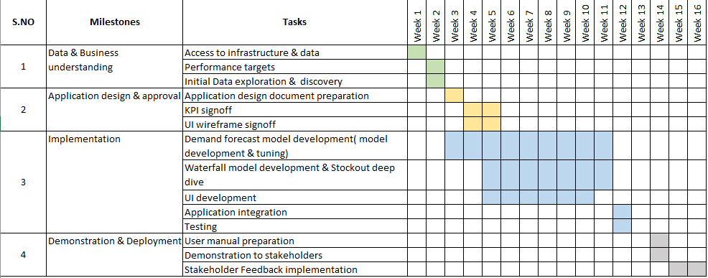
Timelines for the use cases – Stock out
S1
S2
S3
S3
Milestones
S1
Design signoff
Assumption
Only one round of iteration is planned in the scope.
Model updation on based on the future data is not planned . This will call for short iteration cycle
Lead indicators for the stockout will be proposed and signoff at S1.
S2
Interim forecast model delivery
S3
Working solution ready
Development iteration based on stakeholders feedback & review
S4

Slide 31
Timelines for the use cases – Raw material inventory
S.NO | Milestones | Tasks | Week 1 | Week 2 | Week 3 | Week 4 | Week 5 | Week 6 | Week 7 | Week 8 | Week 9 | Week 10 | Week 11 | Week 12 | Week 13 | Week 14 | Week 15 | Week 16
1 | Data & Business understanding | Access to infrastructure & data
 |  | Performance targets
 |  | Initial Data exploration & discovery
 |  | Initial Exploratory Analysis and Insights
2 | Data mart development | Database Architecture Design
 |  | Reporting Layer and Staging Layer development
 |  | UAT signoff
 |  | Query optimization
3 | Application design & approval | Application design document preparation
 |  | KPI signoff
 |  | UI wireframe signoff
4 | Implementation | algorithm development & implementaion
 |  | UI development
 |  | Application integration
 |  | Testing
5 | Demonstration & Deployment | User manual preparation
 |  | Demonstration to stakeholders
 |  | Stakeholder Feedback implementation
R1
R2
R3
Milestones
R1
Design signoff
Assumption
Datamart design will be based on flat files received.
#Dossiers and views will be finalized on design change by Bridgestone stake holders
R2
Working solution ready
Development iteration based on stakeholders feedback & review
R3

Slide 32
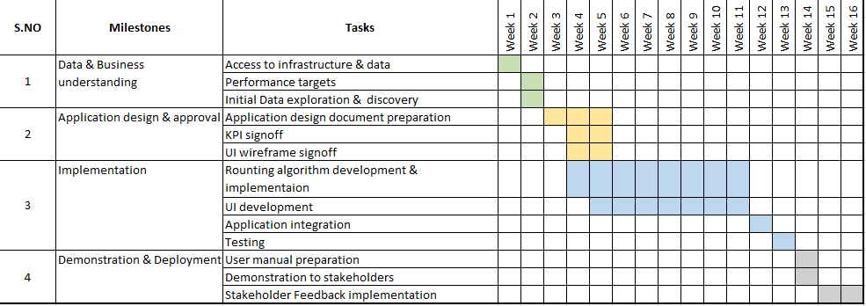
Timelines for the use cases – Milk Run routing
M1
M2
M3
Milestones
M1
Design signoff
Assumption
Only one round of iteration is planned in the scope.
Model updation on based on the future data is not planned . This will call for short iteration cycle
Data required for milk run is yet to be figured out. This should be completed before M1.
M2
Working solution ready
Development iteration based on stakeholders feedback & review
M3

Slide 33
Pricing
Fixed bid pricing
1
Team skills
Supply chain expert
UI engineer
Requirement engineer
Full stack developer
Data scientist
AWS Application engineer
Stock out Index
+
2
Milk route planning
+
Fixed Scope model
Delivery based on milestone & timelines accepted
Plug & Play team setup
3
Raw material inventory planning
Total cost: $ 100,000*
** Does not include tax & other charges

Slide 34






Project assumptions
Areas
Details
Point of Contact (POC)
The designated Point of Contact (POC) would help in coordinating Knowledge Transfer sessions, access to business teams for business understanding and data queries
Review of deliverables, project status tracking and resolving queries / issues
Availability of SME’s
Access to SMEs would be important for the LatentView team to familiarize itself with the business and data environment, existing architecture, understanding of the systems and processes that Bridgestone follows
Timeline Assumptions
Access to data will be provided within the first week of project kick-off and most data queries resolved before the end of week 2 of the project
Documentation: Data Dictionary / DB
Bridgestone would provide LatentView team with the documentation on the existing setup and data dictionary which would help in aggregation of the requisite data
Requisite Access: DB’s / Systems
Support from Bridgestone team to help the LatentView team setup the requisite infrastructure from Chennai office
Quick setup of ID’s, requisite access and permissions to the team members
Setup Virtual Machine access / Staging environment for the offshore team
Infrastructure
Technology Infrastructure to store the data, and host the infrastructure will be provided by Bridgestone
Alternatively LatentView can use an cloud based system such as AWS or Azure, this would be billed on actuals and not included the pricing mentioned here

Slide 35
Timelines and pricing - Option 2(POC)

Slide 36
Scope for the POC
LatentView proposes the following scope for the 3 use cases as a POC
Project | Scope
Stock-out | Develop Forecasting model at store level ( time Granularity : Day level) for one defined region Output : executable ML model
Milk run route optimization | Statistical analysis & insights of historical trip data Output: Insight report covering routes, products, etc
Raw-material inventory management | Statistical analysis & insights of historical inventory data Output: Insight report on inventory KPIs
Cost for the above scope: $ 30,000**
Time: 6 weeks
** Does not include tax & other charges

Slide 37
Thank You

Slide 38














Overall Technical Architecture
ML Model development Module
Data Ingestion
Train ML Model
Data preparation
Data Scientist
Web Hosting
Updated ML model
Input Data
Updated Container
Image
Consumption Layer
End User
Web User Interface
(AngularJs)
API Gateway
Elastic Container Service
Elastic Container Registry
Protect & Secure Access
Illustrative
Identity & Access
Management
Security Token
Service
CloudWatch
CloudTrail
Key Management
Service

